Slide 1
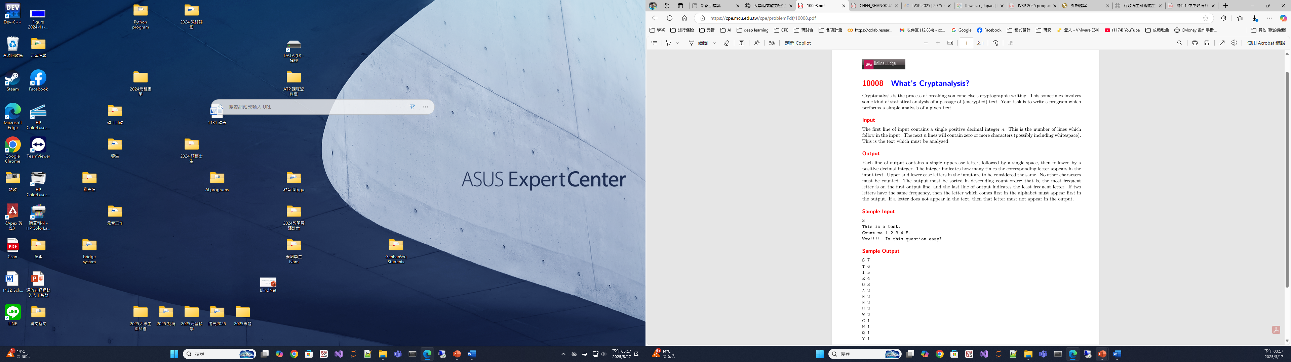

Slide 2
Stable sorting
1
2a
2b
3
2a
1
2b
3
2a
1
2b
3
3
1
2b
2a
for (int i=0; i<3; i++)
for (j=i; j<4; j++)
if (a[i] < a[j])
swap (a[i], a[j])
Not stable
for (int i=0; i<3; i++)
for (j=0; j<3; j++)
if (a[j] < a[j+1])
swap (a[j], a[j+1])
1
2a
2b
3
2a
1
2b
3
2a
2b
1
3
2a
2b
3
1
Stable

Slide 3
#include <iostream>
#include <cstring>
#define len 5000
using namespace std;
int main() {
  int n, length, i, j, t;
  char msg[len];
  char alp[27] = “ABCDEFGHIJKLMNOPQRSTUVWXYZ”;
  int num[27] = {};
  cin >> n;
  cin.ignore();
  for (i = 0; i < n; i++) {
    cin.getline(msg, len);
    length = strlen(msg);
    for (j = 0; j < length; j++)
    if (isalpha(msg[j]))
    num[toupper(msg[j]) – ‘A’]++;
  }
  for (i = 0; i < 26; i++) {
    for (j = 0; j < 26; j++) {
      if (num[j] < num[j + 1]) {
        t = num[j];
        num[j] = num[j + 1];
        num[j + 1] = t;
        t = alp[j];
        alp[j] = alp[j + 1];
        alp[j + 1] = t;
      }
    }
  }
  for (j = 0; j < 26; j++)
    if (num[j])
    printf("%c %d\n", alp[j], num[j]);
  return 0;
}
5
I think
Applepay is good
And
Linepay
Also good
3
This is a test.
Count me 1 2 3 4 5.
Wow!!!! Is this question easy?
S 7
T 6
I 5
E 4
O 3
A 2
H 2
N 2
U 2
W 2
C 1
M 1
Q 1
Y 1
A 5
O 5
I 4
P 4
D 3
L 3
N 3
E 2
G 2
S 2
Y 2
H 1
K 1
T 1

Slide 4
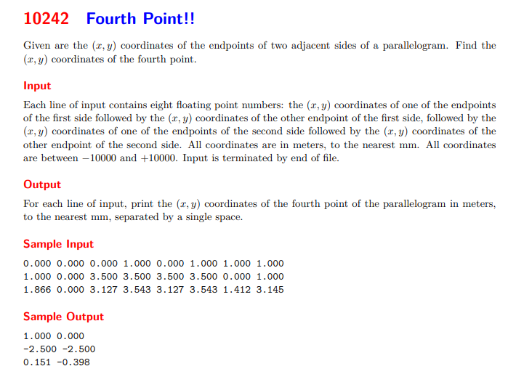

Slide 5
2
1, 3
2
1, 4
4
3
p
p
2 – p = 1 – 4 ➔ p = 2 + 4 - 1
2 – p = 1 – 3 ➔ p = 2 + 3 - 1
1
2, 3
1
2, 4
4
3
p
p
1 – p = 2 – 4 ➔ p = 1 + 4 - 2
1 – p = 2 – 3 ➔ p = 1 + 3 - 2

Slide 6
#include <iostream>
#include <iomanip>
using namespace std;
int main() {
double x1, y1, x2, y2, x3, y3, x4, y4, x, y;
while (cin >> x1 >> y1 >> x2 >> y2 >> x3 >> y3 >> x4 >> y4) {
if (x1 == x3 && y1 == y3) {
x = x2 + x4 - x1;
y = y2 + y4 - y1;
}
else if (x1 == x4 && y1 == y4) {
x = x2 + x3 - x1;
y = y2 + y3 - y1;
}
else if (x2 == x3 && y2 == y3) {
x = x1 + x4 - x2;
y = y1 + y4 - y2;
}
else {
x = x1 + x3 - x2;
y = y1 + y3 - y2;
}
cout << fixed << setprecision(3) << x << " " << fixed << setprecision(3) << y << endl;
}
return 0;
}
0.000 0.000 0.000 1.000 0.000 1.000 1.000 1.000
1.000 0.000 3.500 3.500 3.500 3.500 0.000 1.000
1.866 0.000 3.127 3.543 3.127 3.543 1.412 3.145
1.000 0.000
-2.500 -2.500
0.151 -0.398

Slide 7
0.000 0.000 0.000 1.000 0.000 1.000 1.000 1.000 1.000 0.000 3.500 3.500 3.500 3.500 0.000 1.000 1.866 0.000 3.127 3.543 3.127 3.543 1.412 3.145 0.000 0.000 0.000 1.000 0.000 1.000 1.000 1.000 0.000 0.000 0.000 1.000 1.000 1.000 0.000 1.000 0.000 1.000 0.000 0.000 0.000 1.000 1.000 1.000 0.000 1.000 0.000 0.000 1.000 1.000 0.000 1.000 0.000 0.000 10.000 10.000 10.000 -10.000 0.000 0.000 0.000 0.000 10.000 10.000 10.000 -9.876 0.000 0.000 11.111 22.222 33.333 44.444 11.111 22.222 -33.333 -44.444 5.384 6.284 10.333 8.777 5.384 6.284 15.111 -0.877 3.039 -777.666 -50.000 -30.000 -50.000 -30.000 -49.000 8000 3895.102 3029.999 2.212 3.343 2.212 3.343 4939.888 2016.777 1234.567 7654.321 2345.678 8765.432 -1.000 -2.090 1234.567 7654.321 -4718.901 3049.141 -4869.609 3556.058 -4718.901 3049.141 9376.260 -8396.750 -1857.015 -1618.166 -1487.384 648.181 -2660.848 -6343.281 -1857.015 -1618.166
1.000 0.000 -2.500 -2.500 0.151 -0.398 1.000 0.000 1.000 0.000 1.000 0.000 1.000 0.000 20.000 0.000 20.000 0.124 -11.111 -22.222 20.060 1.616 4.039 7252.334 8832.778 5043.433 1110.111 1109.021 9225.552 -7889.833 -2291.217 -4076.934

